Slide 1


Coffee Shop Sales
- Using Power BI

Slide 2
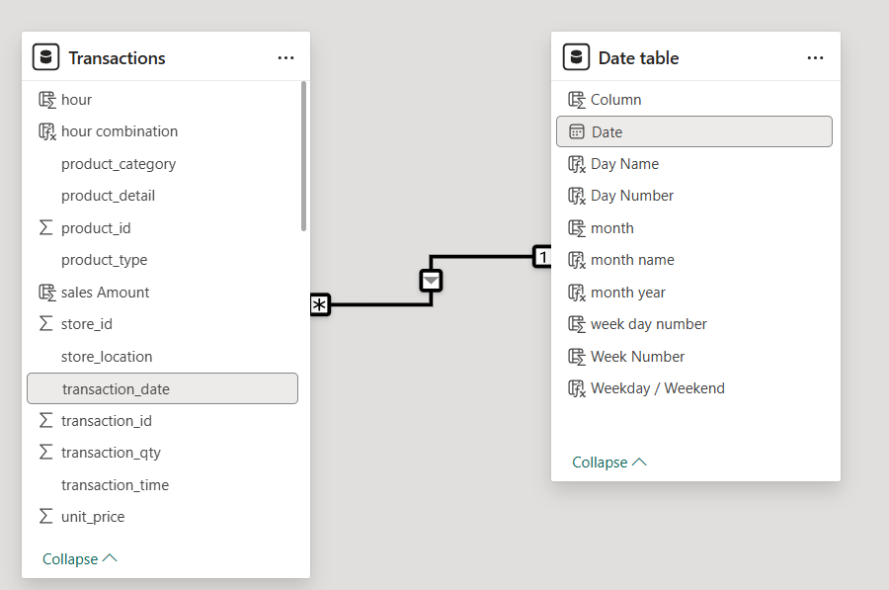
Model View

Slide 3
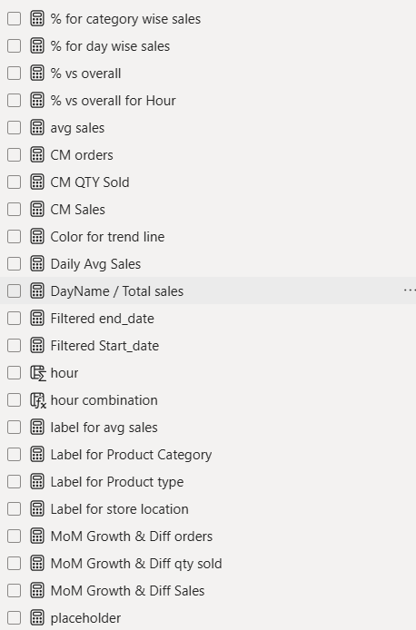
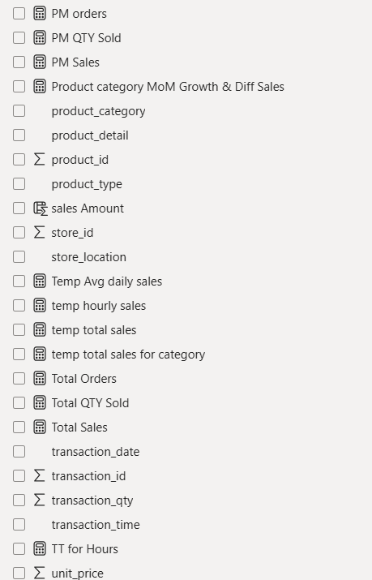
Create New Measure and Column using Different DAX Formula

Slide 4
Dashboard

Slide 5
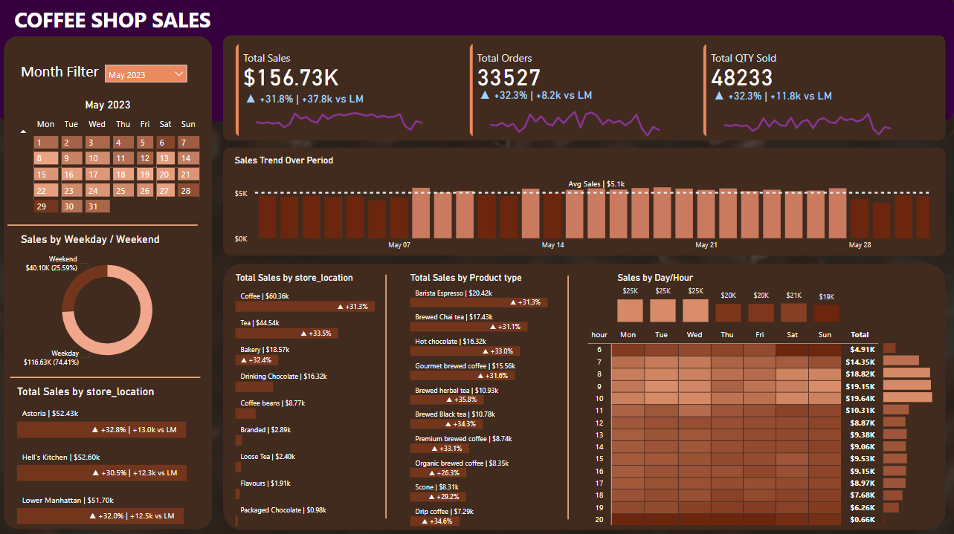

Slide 6
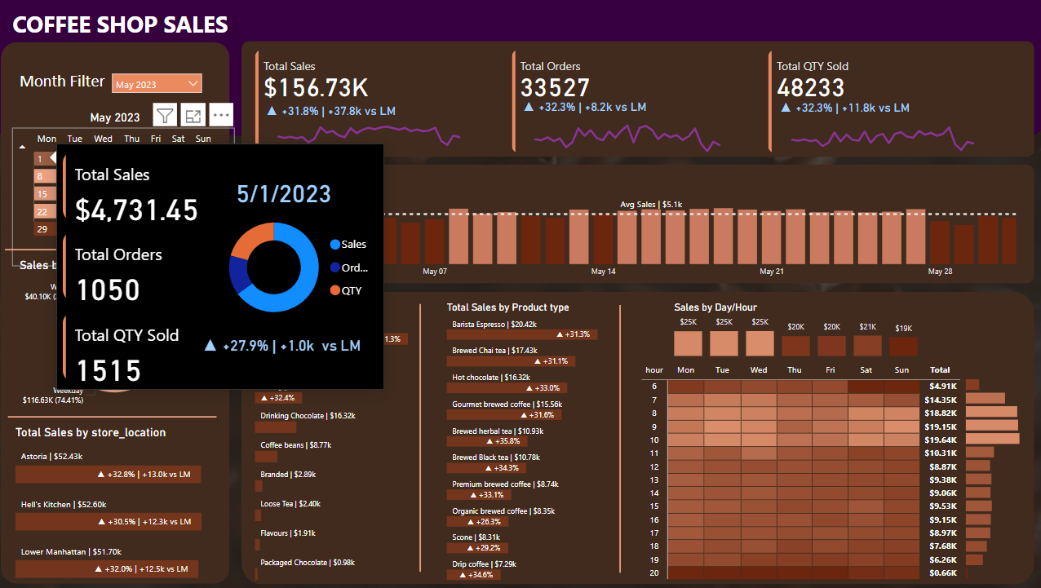

Slide 7
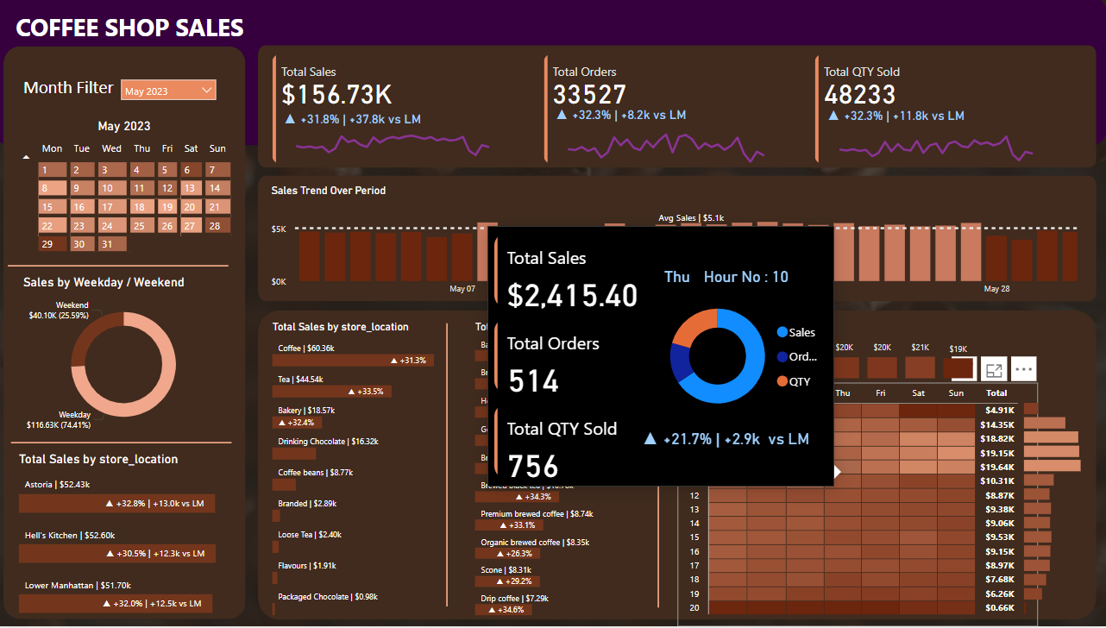

Slide 8
